Slide 1


GRADE 8 ICT/DESIGN
Lesson 1: Try: Prototyping the Smart Clothing Solution
Ms. Abboud • Grade 8 - ICT/Design • Term 1, Week 5

Slide 2
Learning Objectives
WALT - We Are Learning To
WILF - What I'm Looking For
Turn our focus need into a first prototype.
Label how each part meets our design criteria.
My prototype is a genuine attempt to address our need.
My prototype is labeled so someone else can understand it.

Slide 3
Academic Vocabulary
Prototype
Iteration
An early, rough version of a design built to test an idea before making the real thing.
Making a design better through repeated rounds of trying, testing, and improving it.

Slide 4
Frayer Model: Prototype
DEFINITION
CHARACTERISTICS
An early, rough version of a design built to test an idea before making the real thing.
Rough, early, quick to make; meant to be tested, not perfect.
PROTOTYPE
EXAMPLES
NON-EXAMPLES
A paper sketch of an app screen.
The final, polished, published app.

Slide 5
National Identity Integration
UAE spirit of innovation: the UAE often pilots new ideas on a small scale, tests them, and improves them before launching them nationwide. A prototype is our small-scale test.

Slide 6
STARTER
Back to Your Focus Need
Get out your Week 4 planning sheet.
Remind your group: what is your focus need, and what are your 2-3 criteria?
Hook • Engage & Ask
5 - 10 minutes

Slide 7
LESSON CORE
I Do: What Is a Prototype?
Today we turn last week's idea into a quick, rough prototype.
It doesn't need to be perfect. It needs to test the idea.
We expect to change it later. That's iteration.
Gradual Release of Responsibility
35 - 45 minutes
1 / 3

Slide 8
LESSON CORE
We Do: Pick the Idea
As a group, look at your initial ideas from Week 4.
Agree on one idea to prototype and decide who draws which part.
Gradual Release of Responsibility
35 - 45 minutes
2 / 3

Slide 9
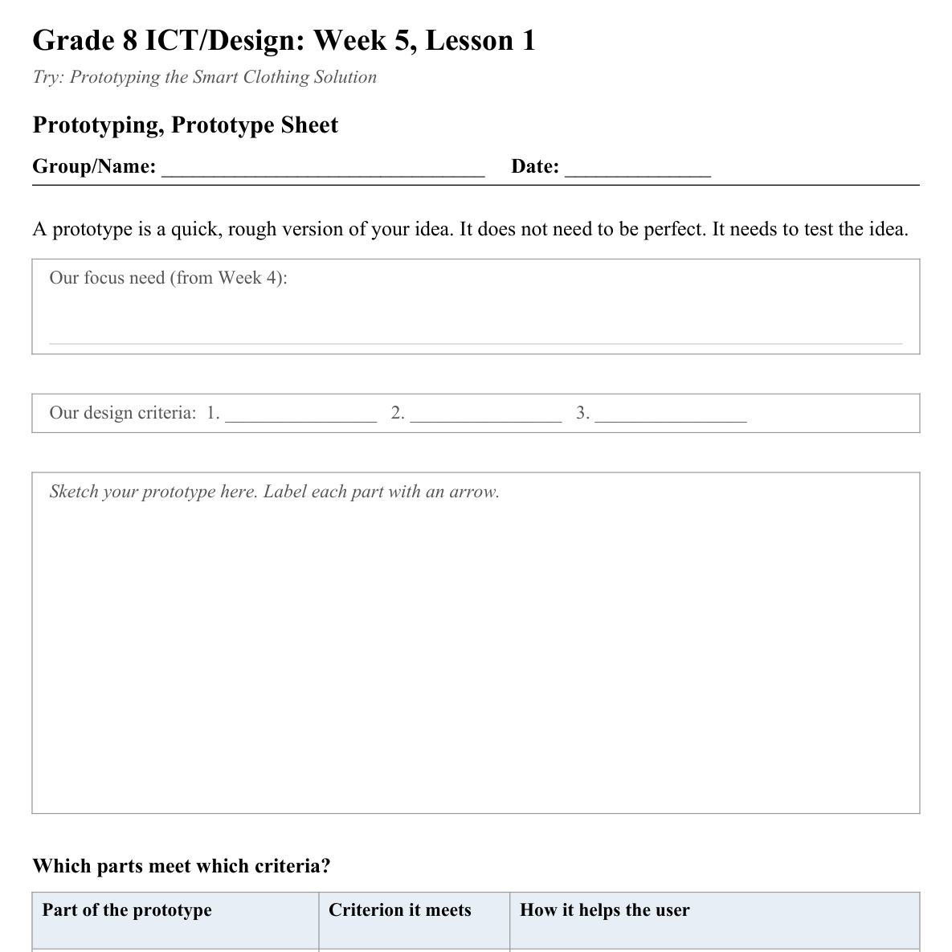
LESSON CORE
You Do: Sketch & Label
Sketch your smart clothing prototype.
Add arrows and labels showing which part meets which criterion.
Activity: Prototyping, Prototype Sheet
Gradual Release of Responsibility
35 - 45 minutes
3 / 3

Slide 10
CLOSURE
Exit Ticket
What's the part of your prototype you're least sure will work?
Transition & Extend
5 - 10 minutes

